Slide 1
Systems Biology 2021 internship data analysis assignment
Michelle Meier
MSc Systems Biology, ETH Zurich

Slide 2
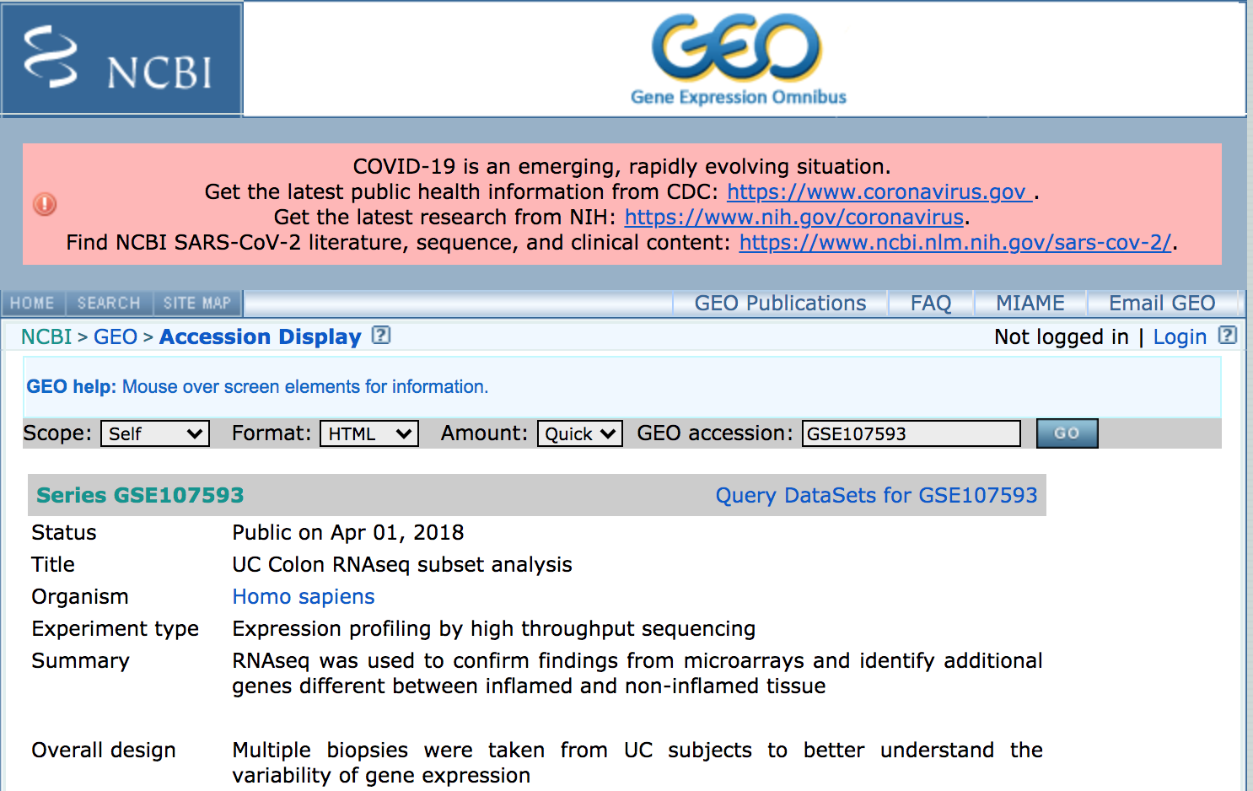
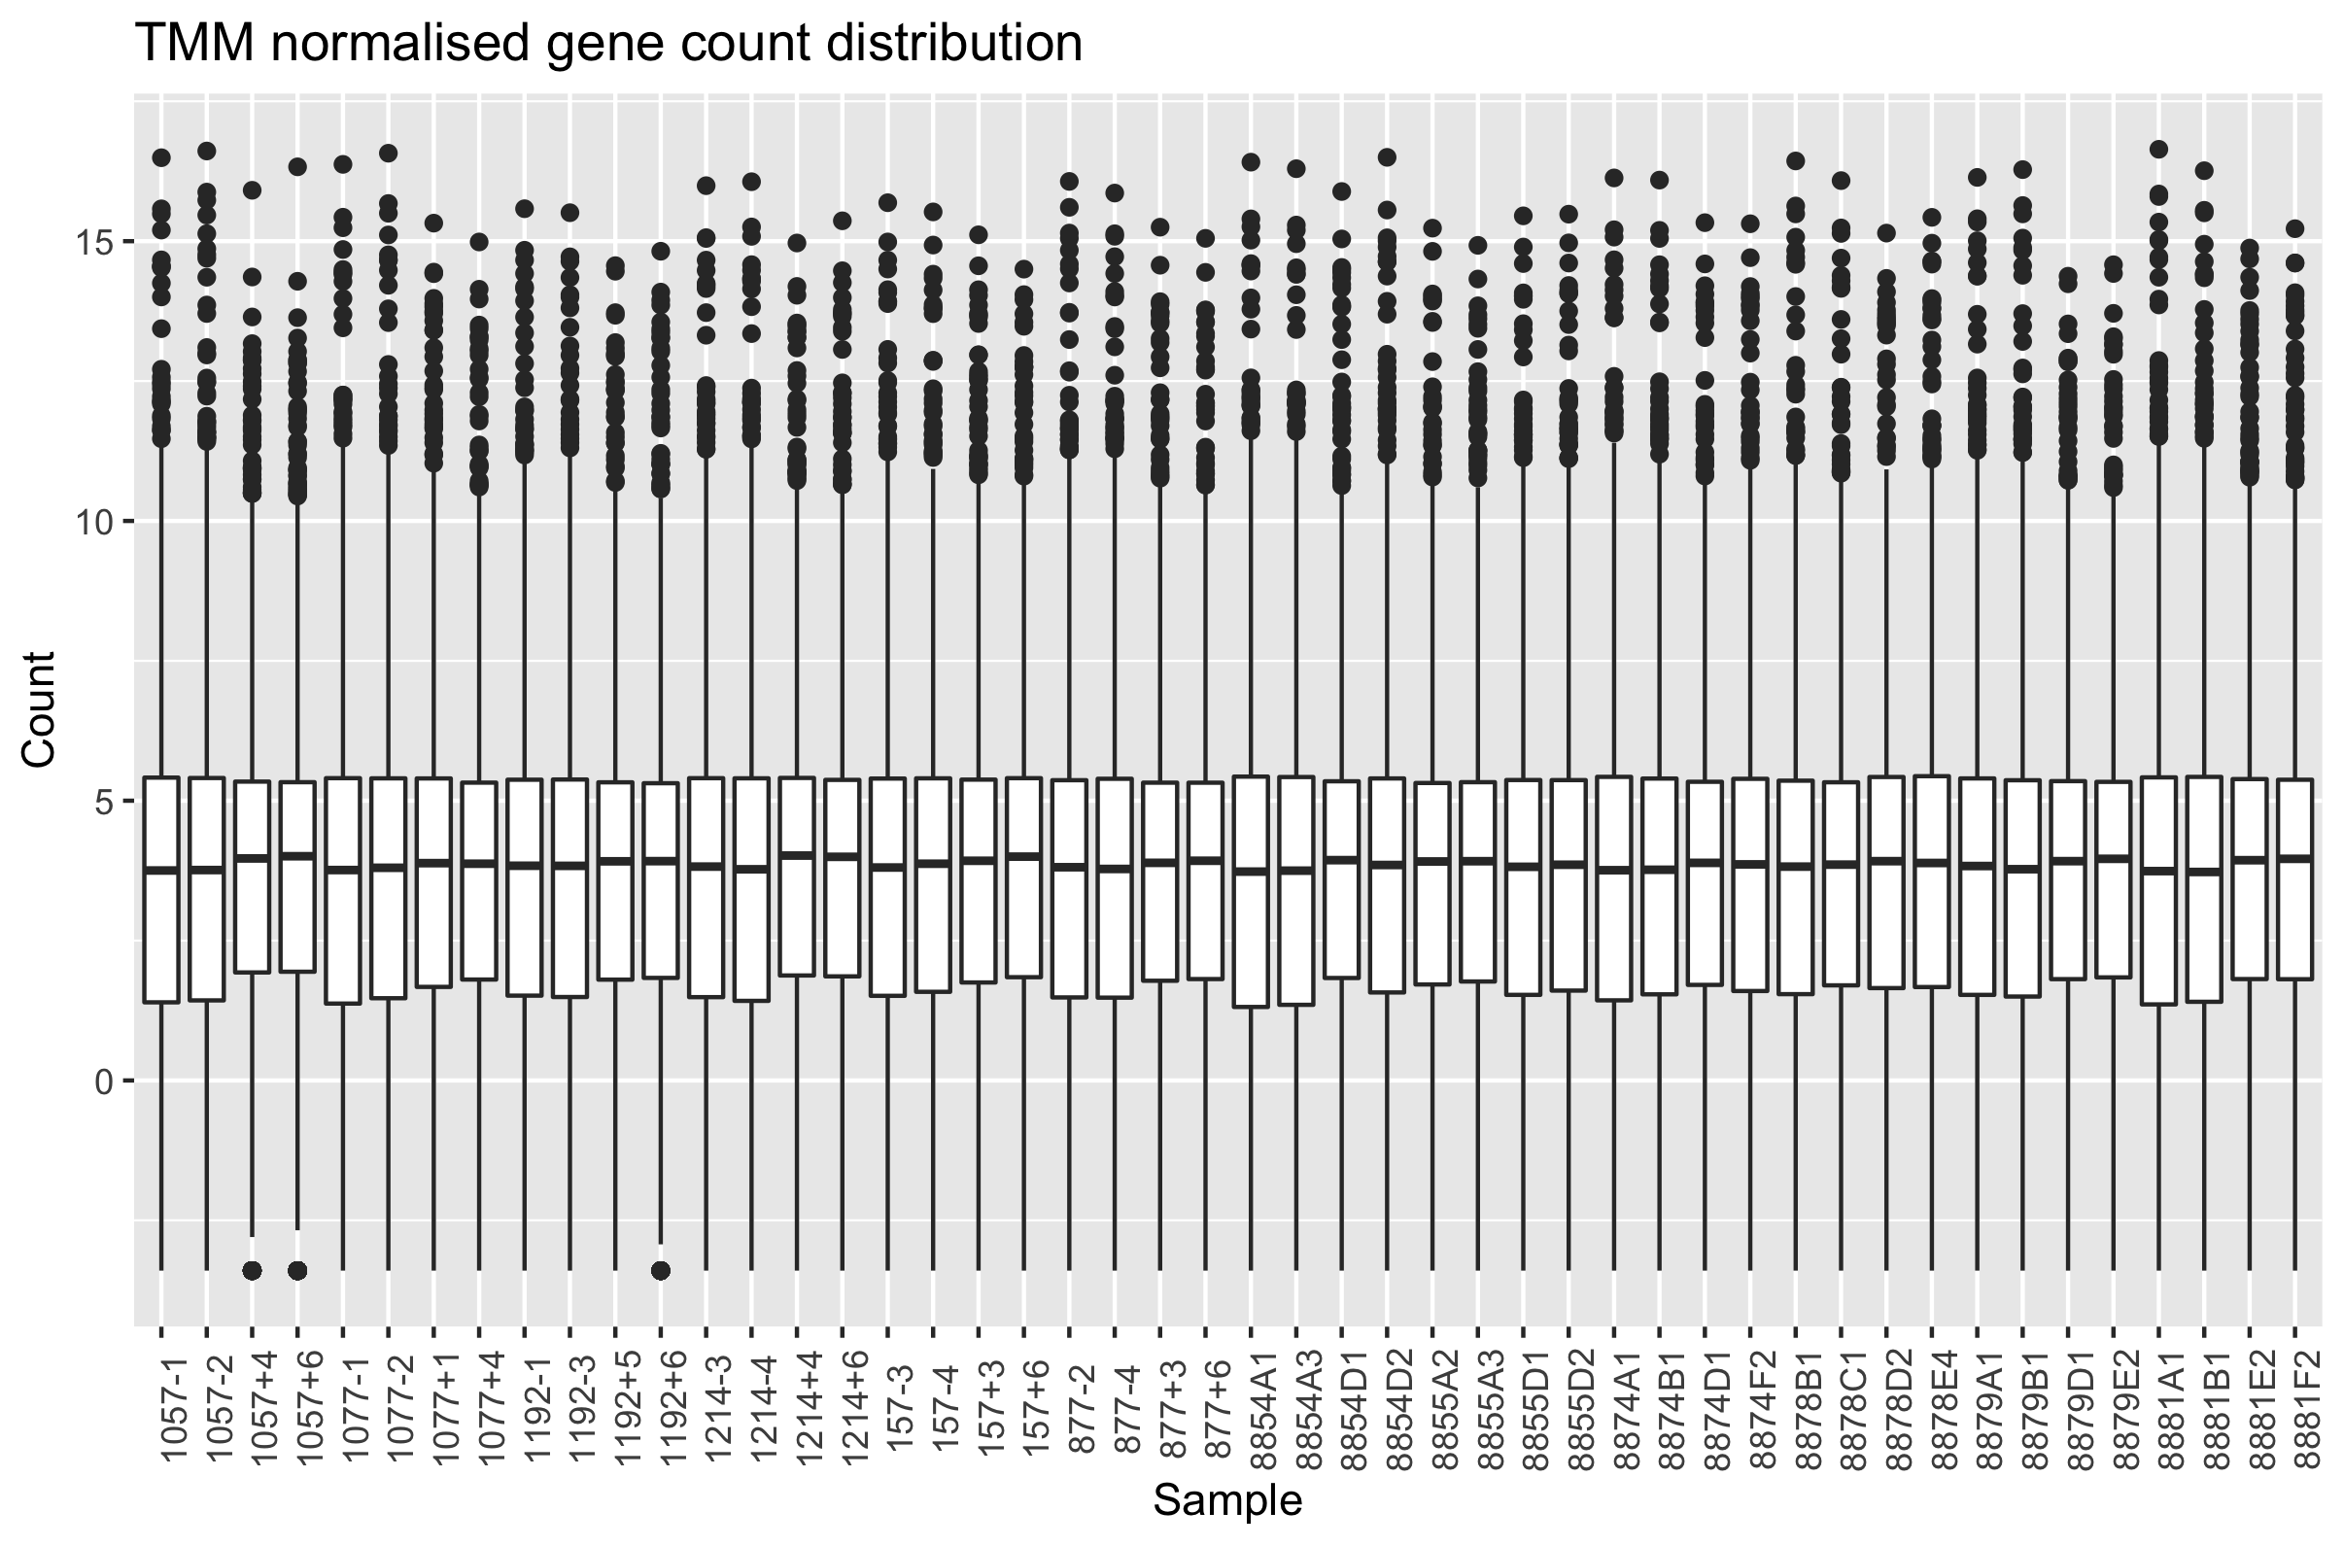
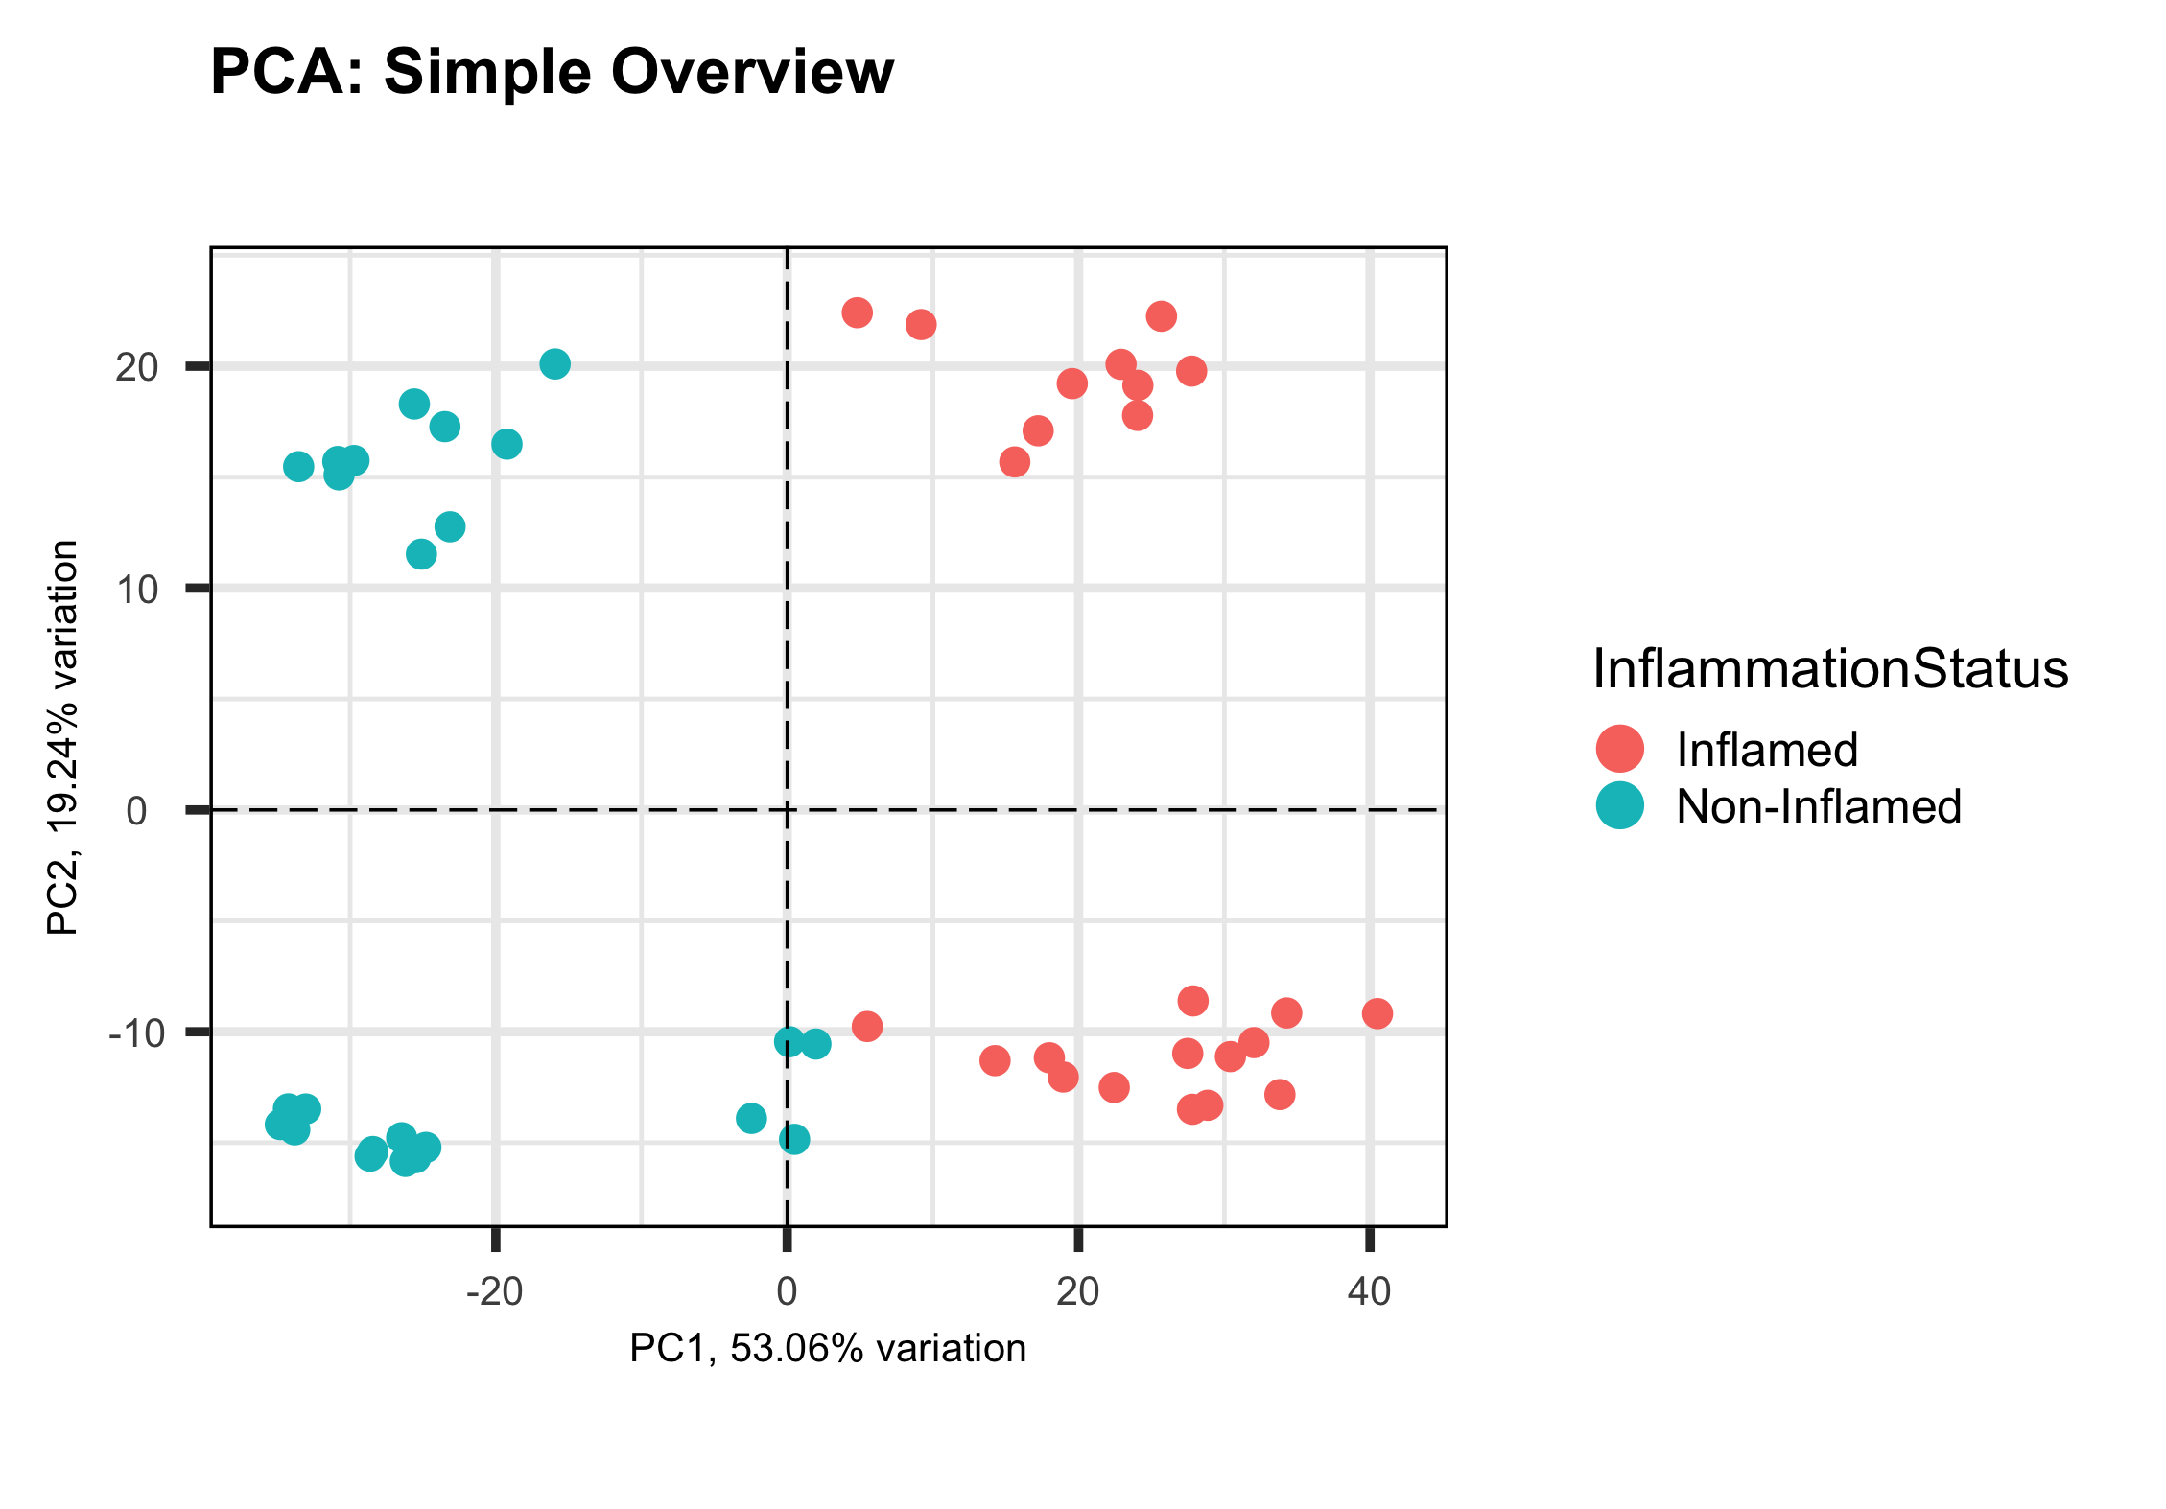
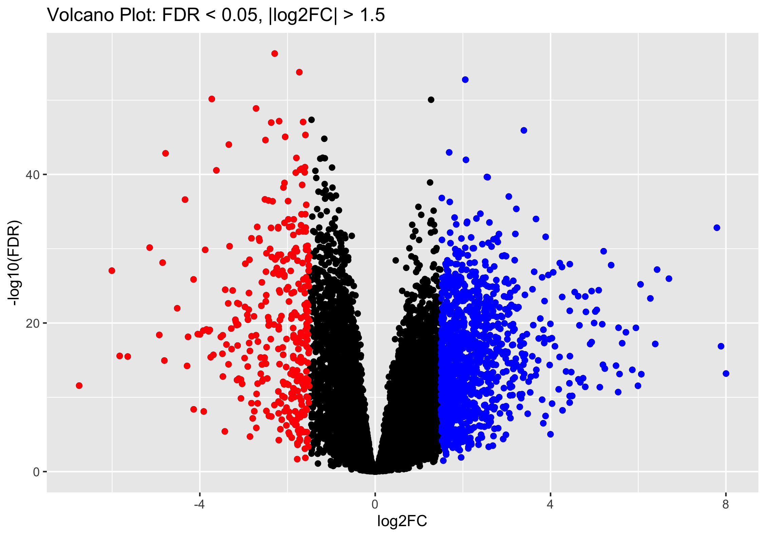
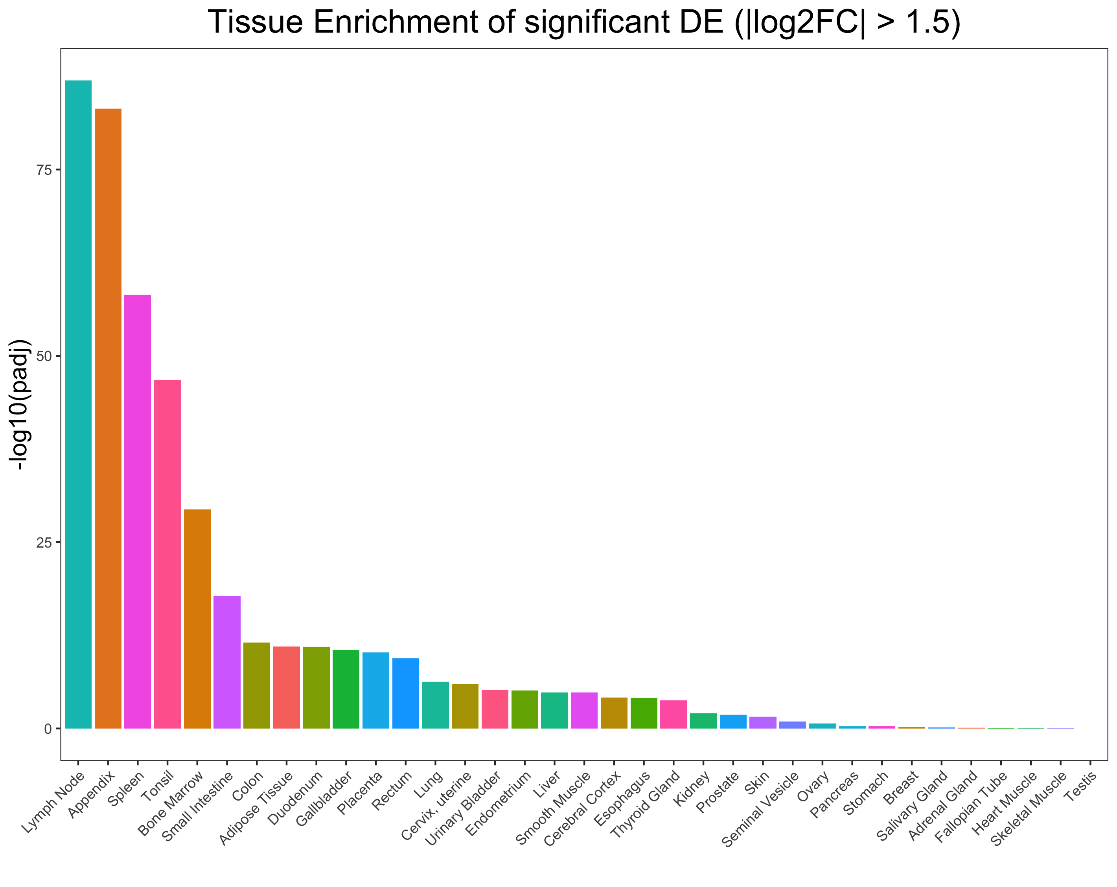
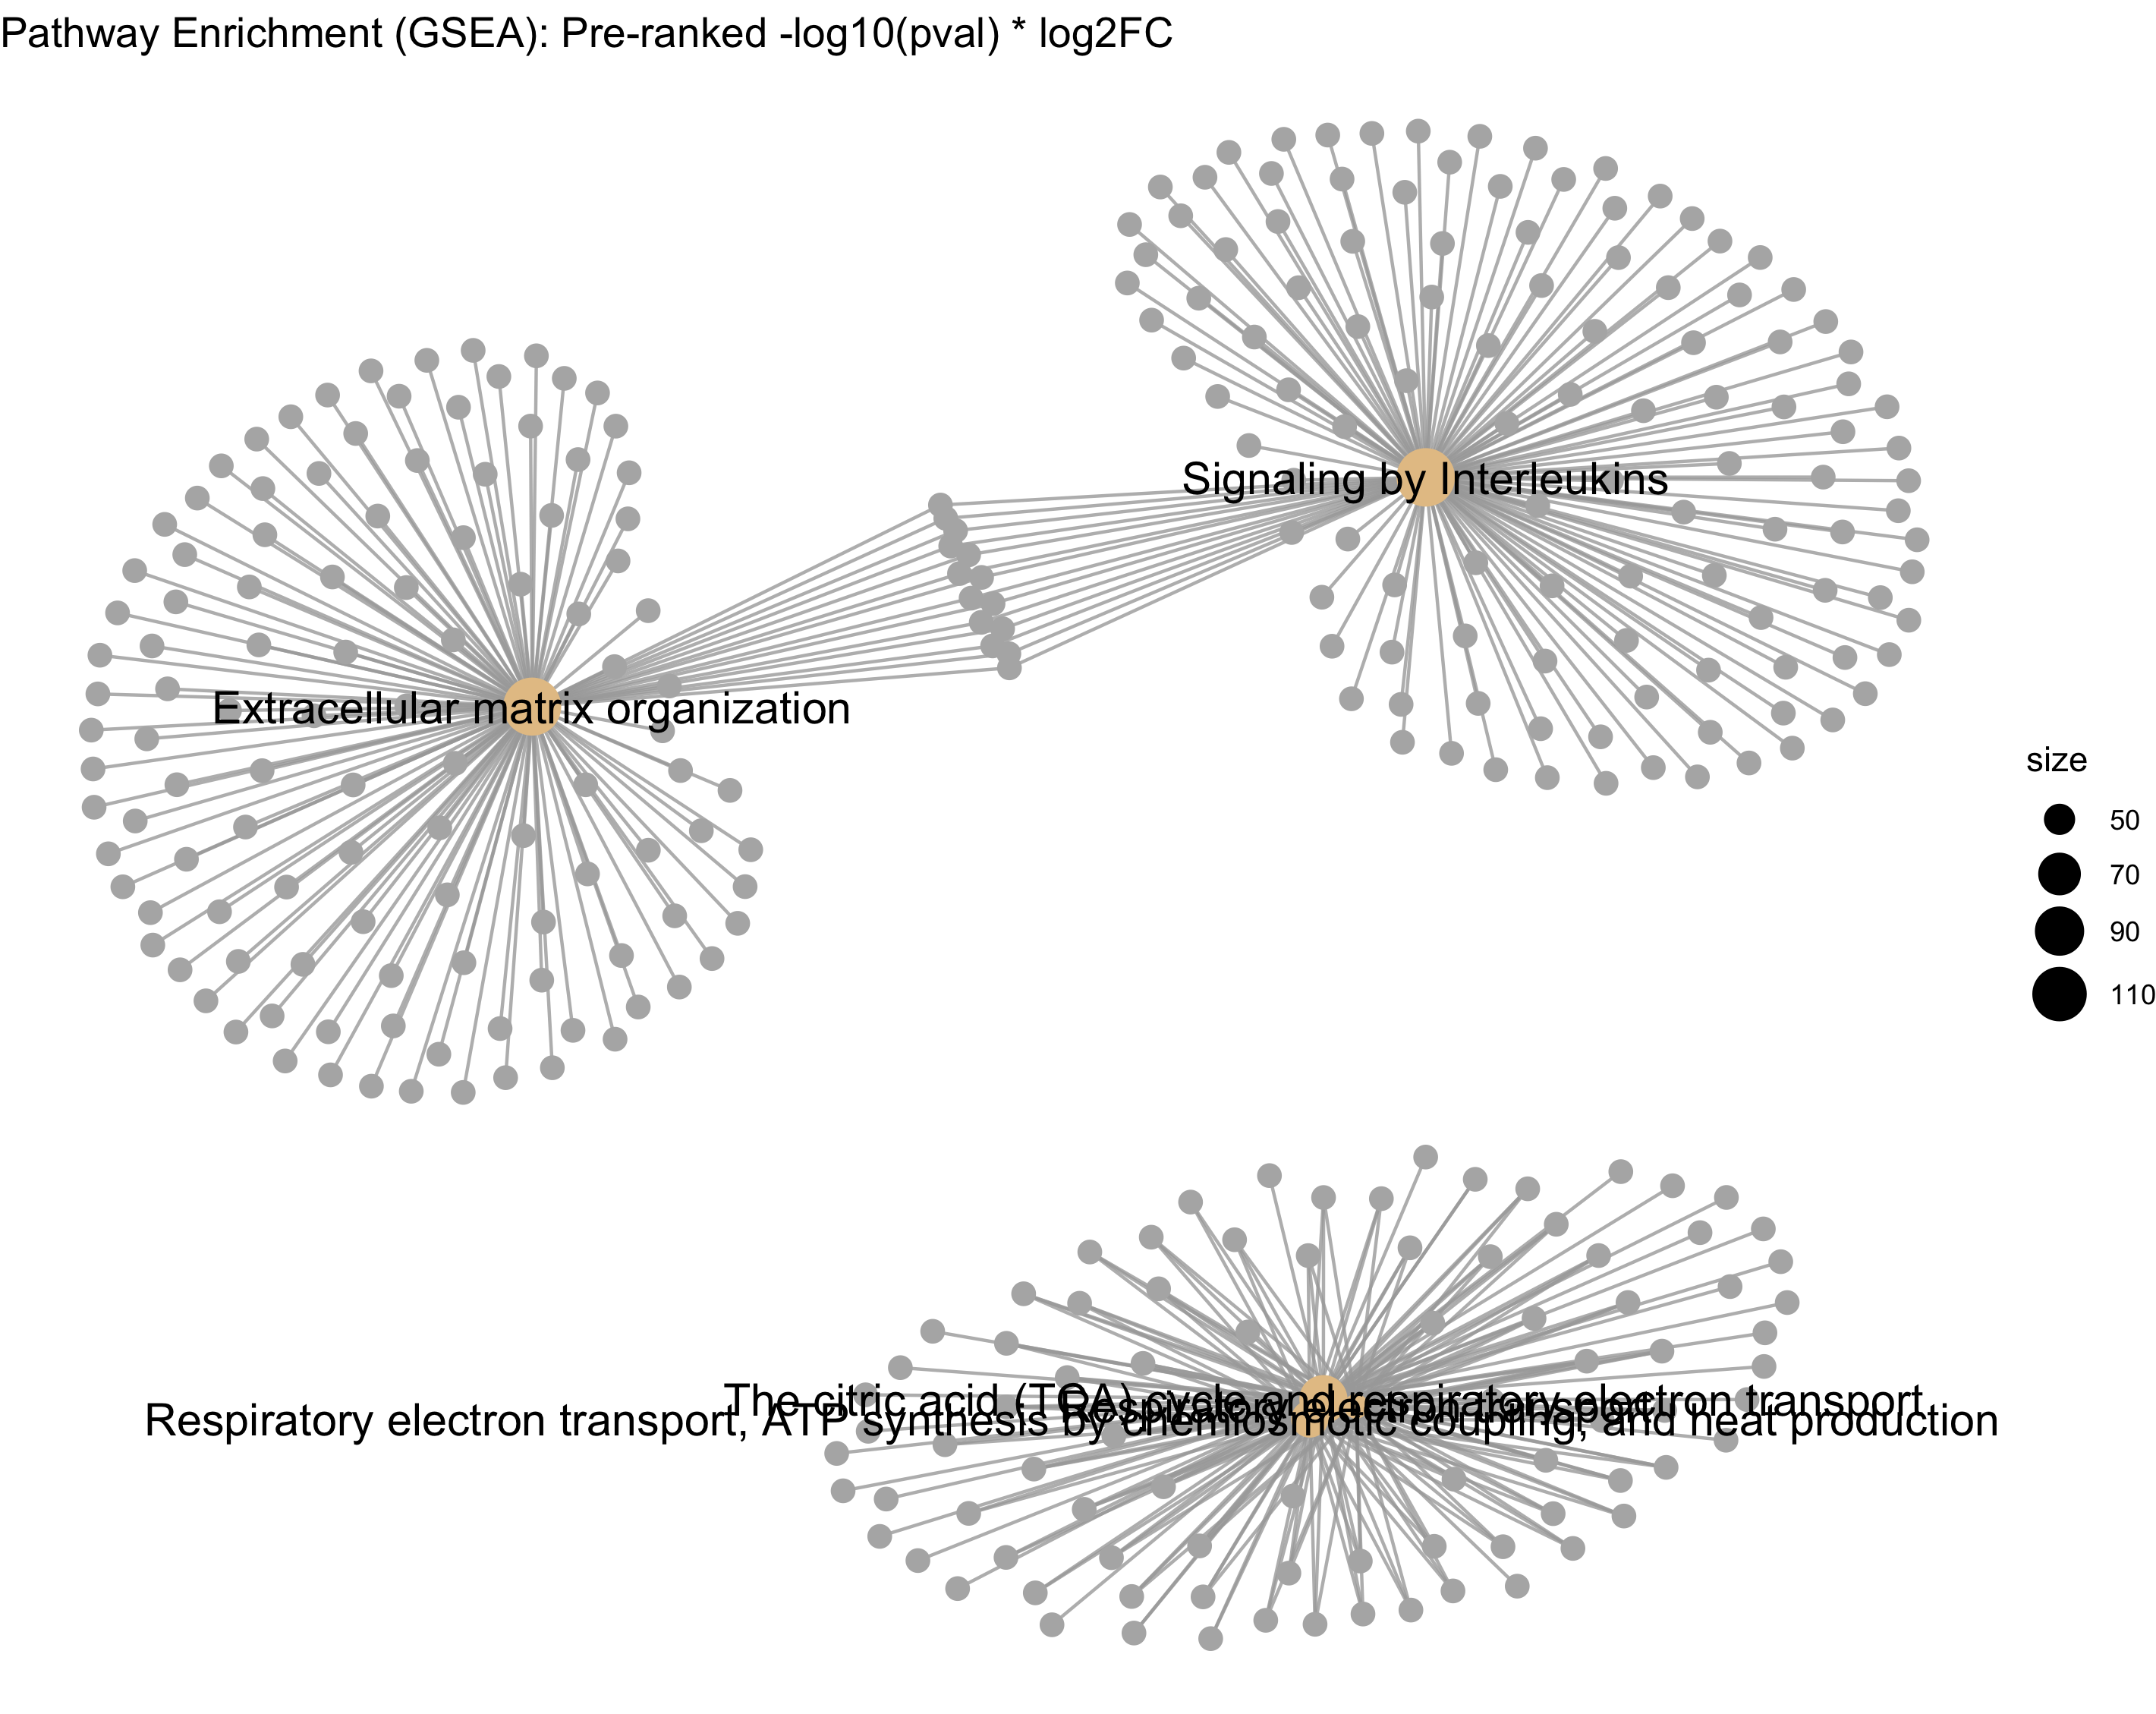
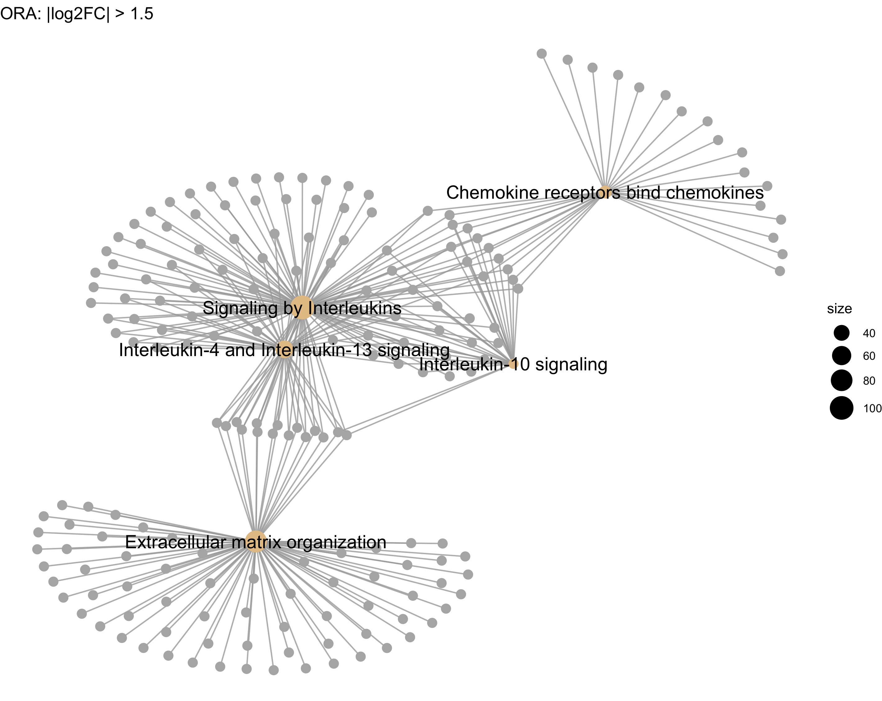

Workflow
Assembly data + meta data from GEO
research on workflow + UC
Normalisation + Quality Control of Counts
Overview of Data
PCA: Reduce Dimensionality
Differential Gene Expression Analysis
get annoyed because there are too many different gene identifiers
Gene Set Enrichment Analysis: Reactome
Over-representation Analysis: Reactome
Tissue Enrichment
panic because I looking back on finished analysis I should have considered patient and/or location effects
Summarise Results

Slide 3
Ulcerative Colitis (UC)
Inflammatory bowl disease: Long-term inflammation and formation of painful ulcers of the lining of colon
Motivation for this study:
Cause for UC is not known/not agreed upon
UC has a high incidence and prevelance rate
current therapeutic strategies only tackle symptoms
severe cases can lead to removal of colon
huge impact on patient’s life and well-being
Notes:
progresses from rectum to other parts of the colon
Prevalence refers to proportion of persons who have a condition at or during a particular time period, whereas incidence refers to the proportion or rate of persons who develop a condition during a particular time period.

Slide 4
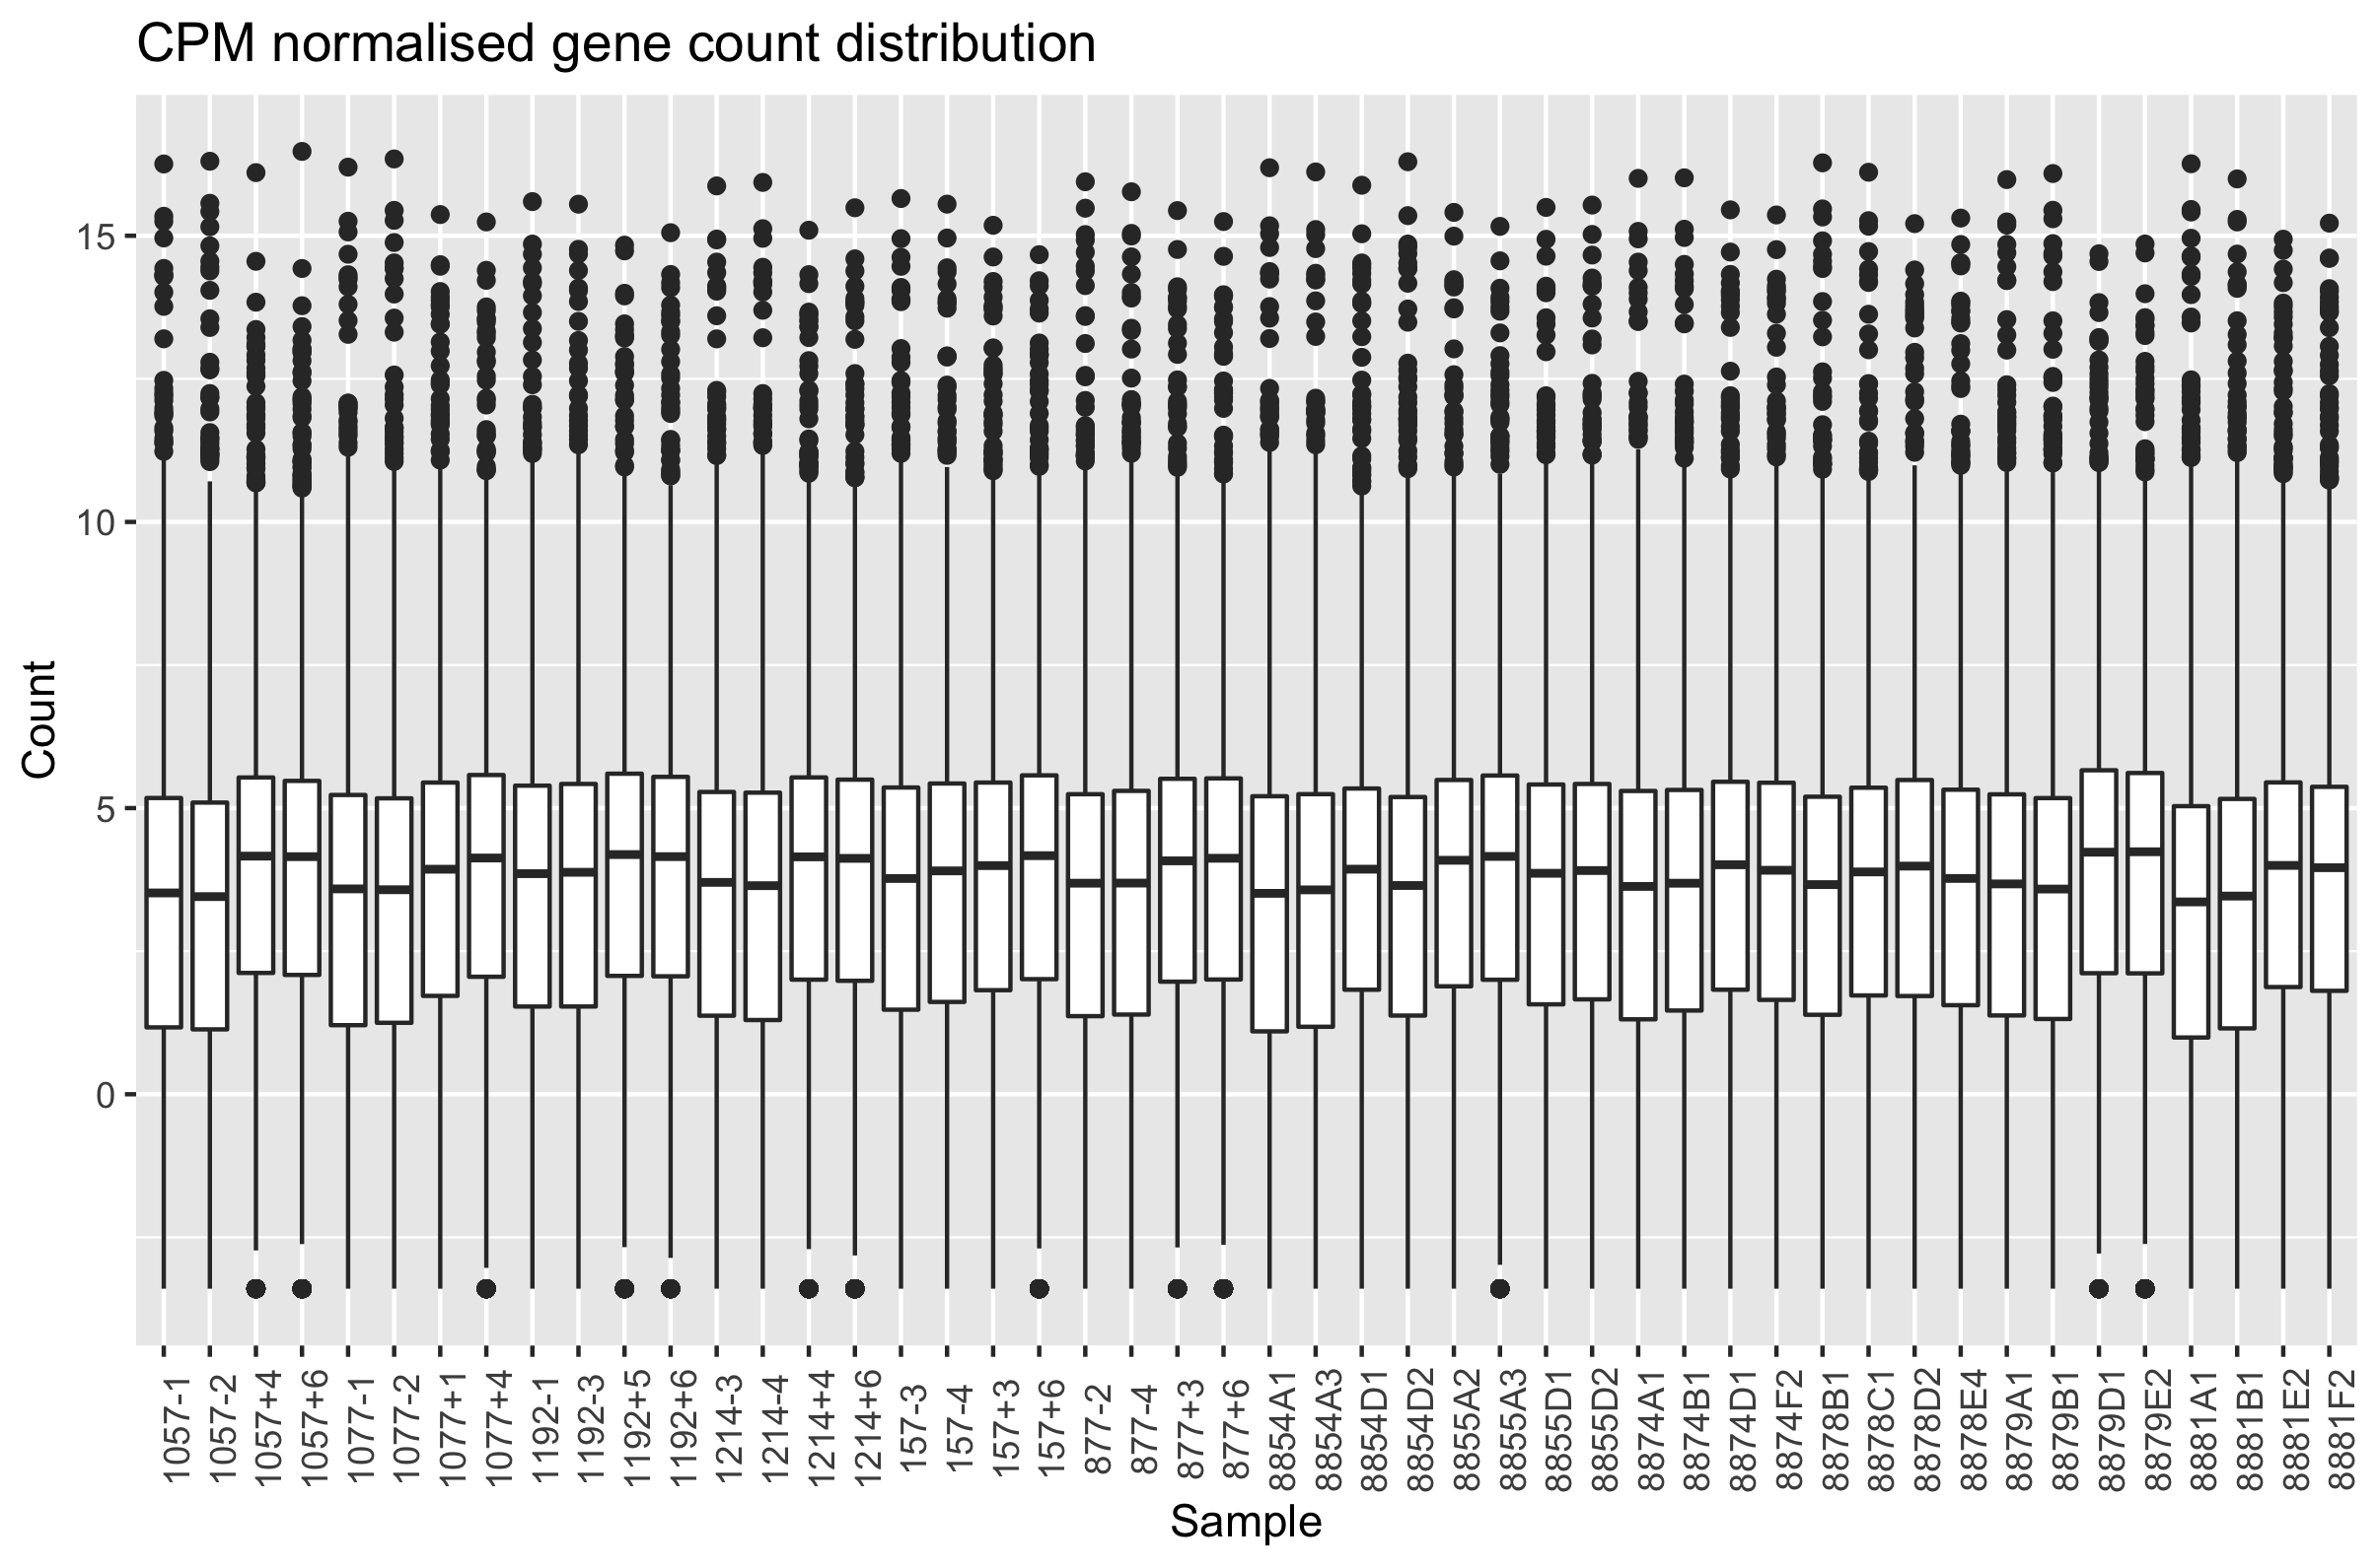
Normalisation + Quality Control of Counts
edgeR
Calculate effective library size (account for library size differences between samples)
trimmed mean of log2 fold change between the two samples (M-value) (TMM)
Notes:
weighted trimmed mean of the log expression ratios:
trims gene-wise logfold changes and absolute expression levels before taking the weighted average
=> edge R does not use gene lengths because assumes that when comparing that doesn’t make a difference because the factor is on both sides (gene-wise comparison)

Slide 5
Overview of Data
no clear batch effects
inflammation status seems to be the main driver of clustering
some clustering in location
Notes:
clustering: euclidean => see which classes cluster together
x axis: patients
y axis: genes
matrix: TMM counts

Slide 6
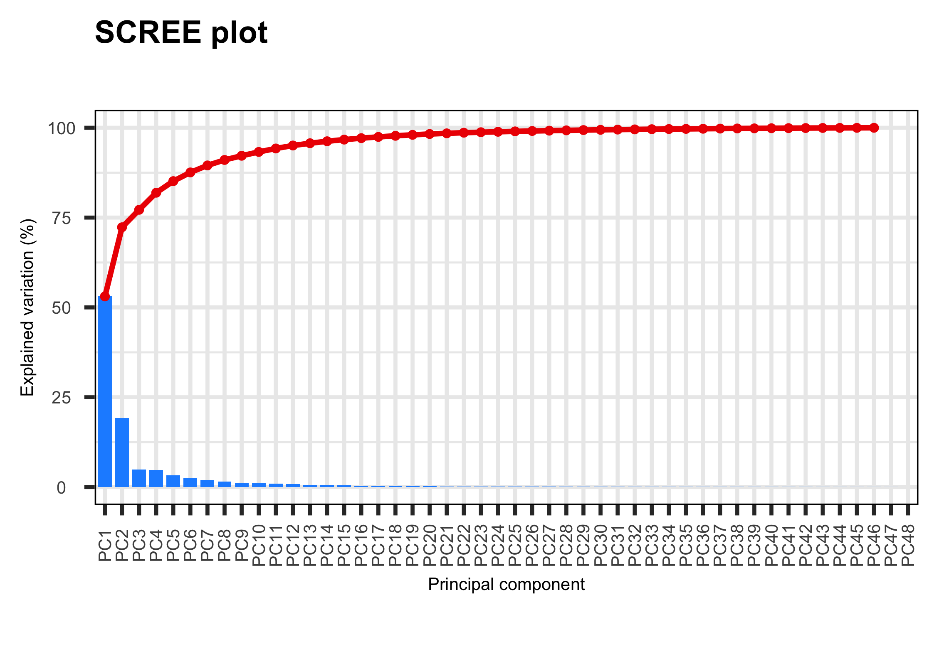
PCA: Reduce Dimensionality
PCAtools
Reducing dimensionality while preserving variance
Notes:
log transformed data

Slide 7
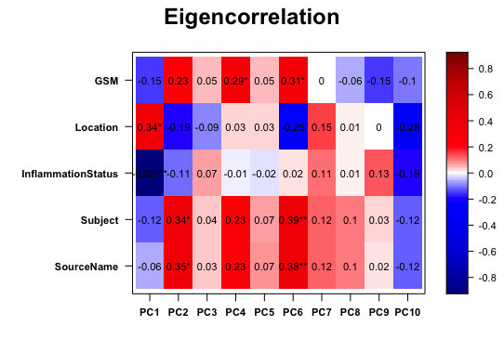
PCA
PCAtools
Clear clustering of inflammed/non-inflammed samples along PC1

Slide 8
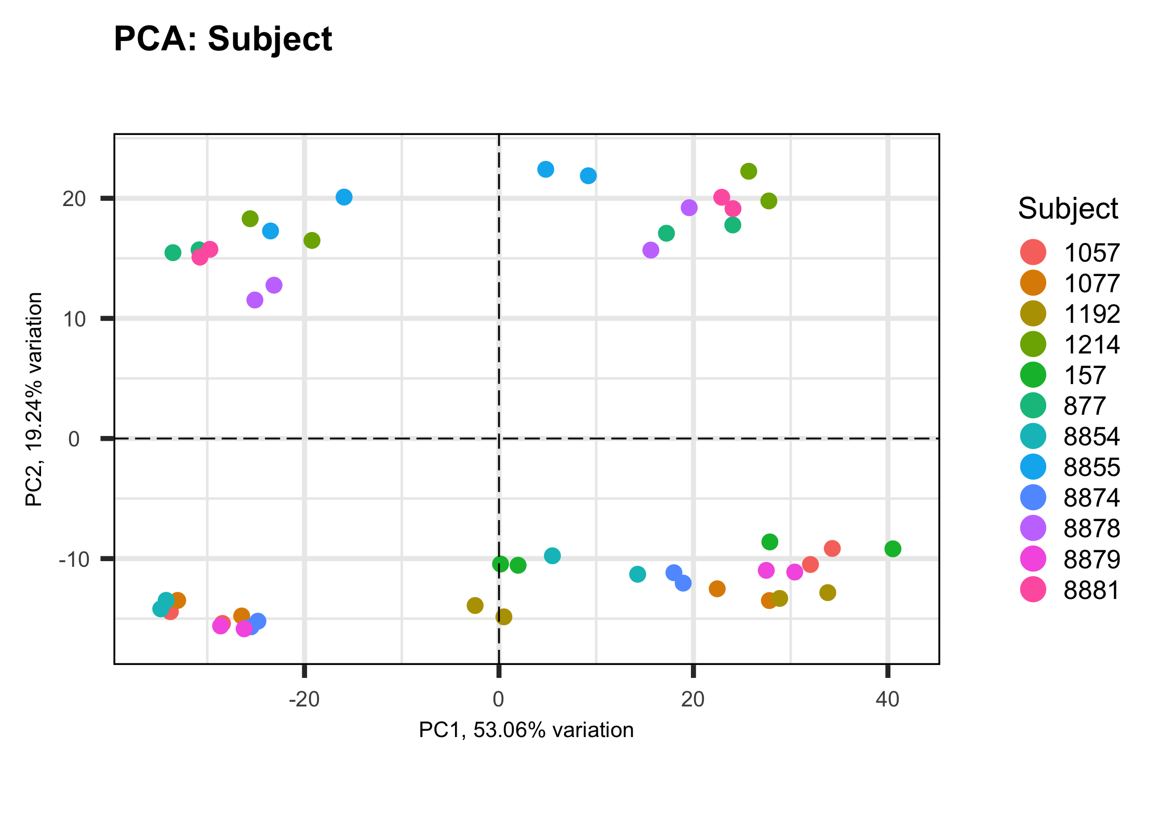
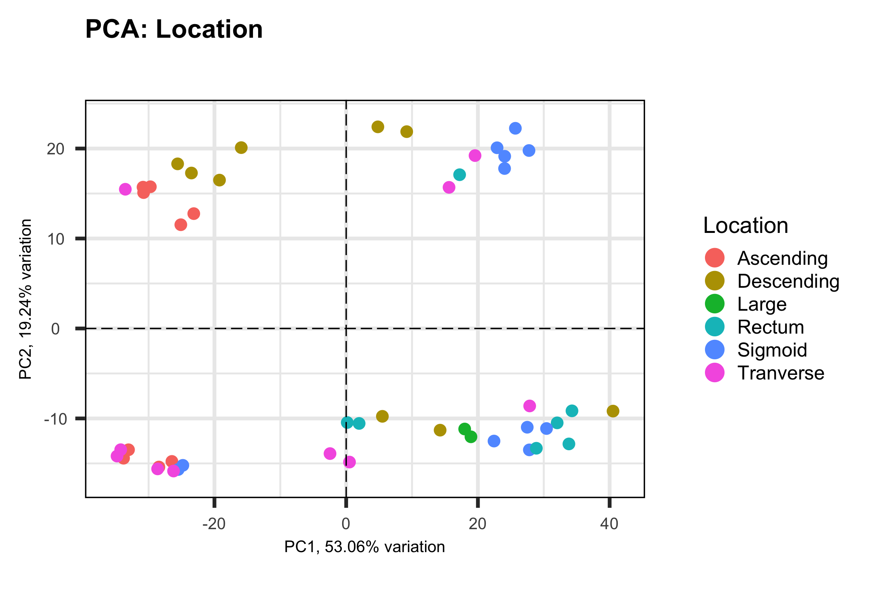
PCA
PCAtools
Patient
Location
more shuffled, still PC2 seems to separate some patients
Some location seperation along PC1

Slide 9
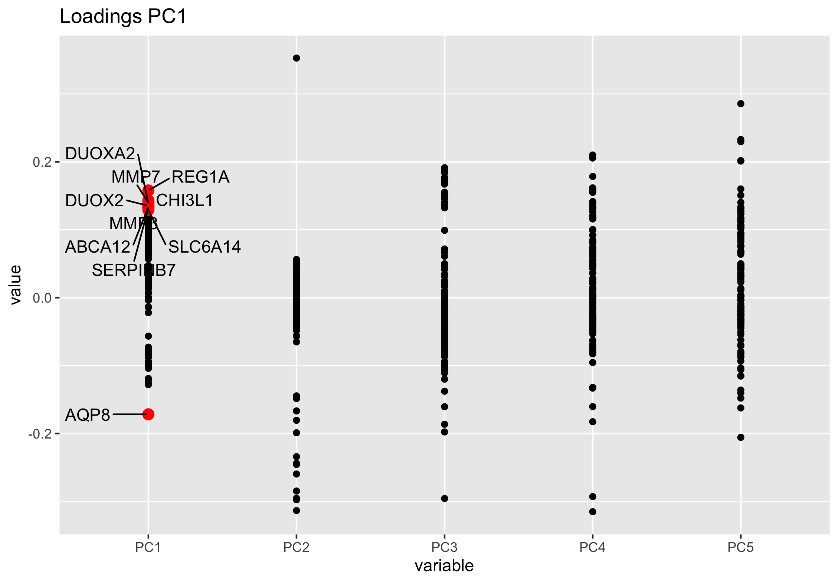
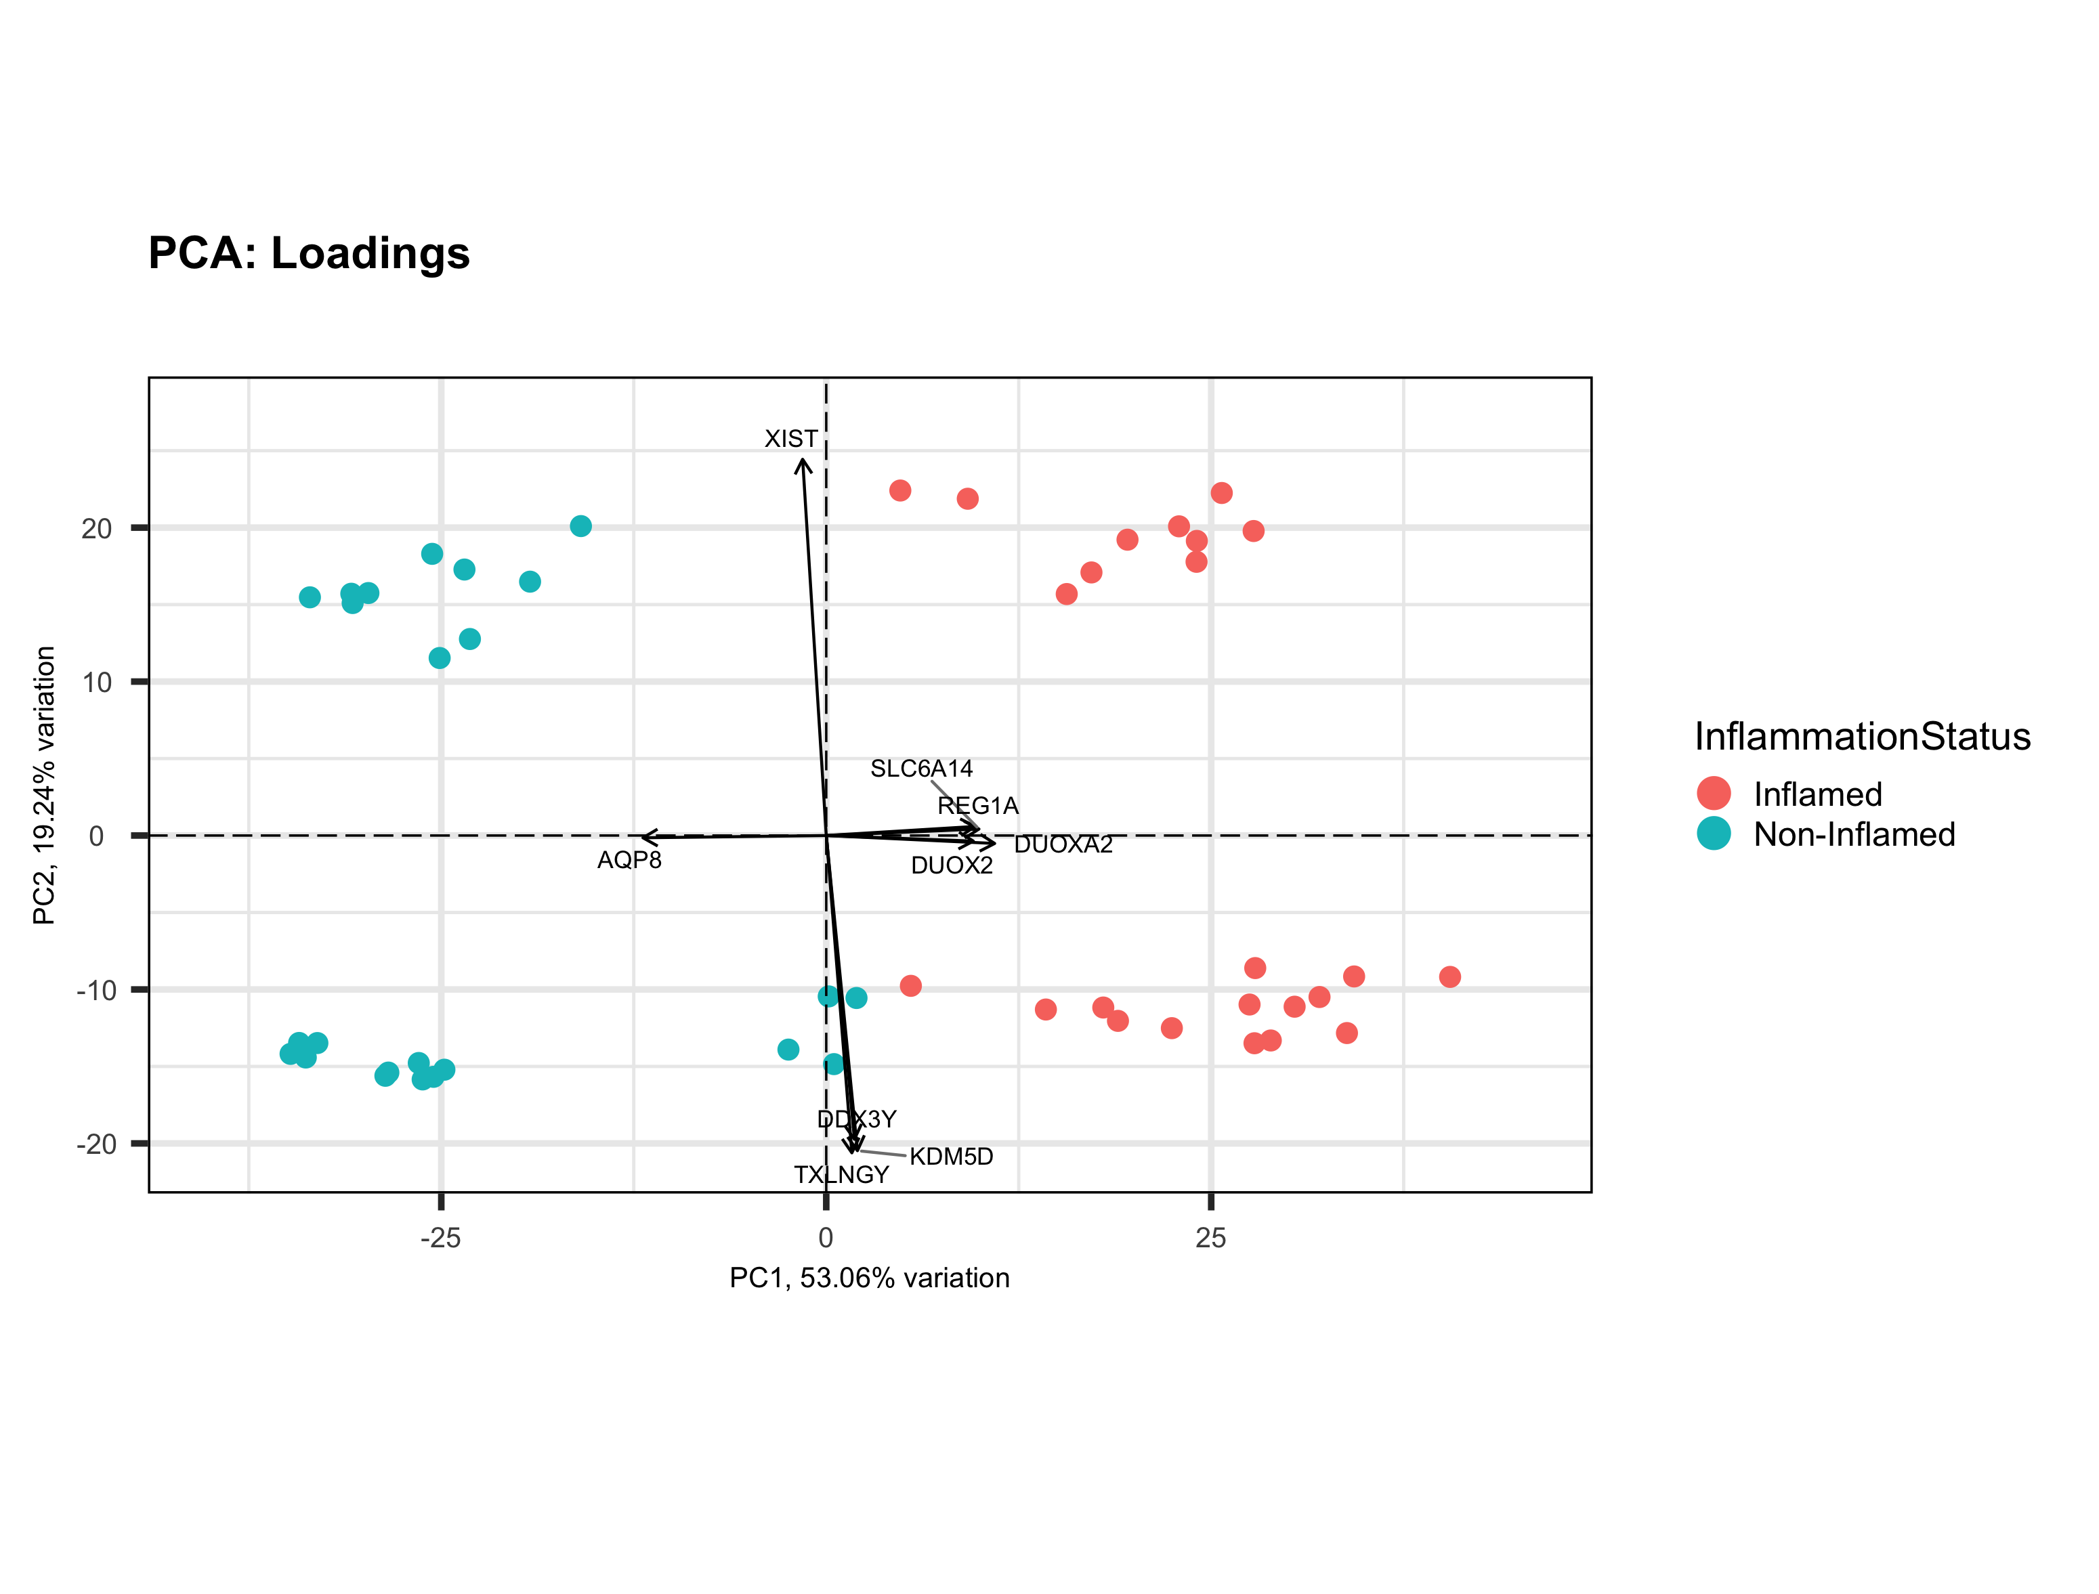
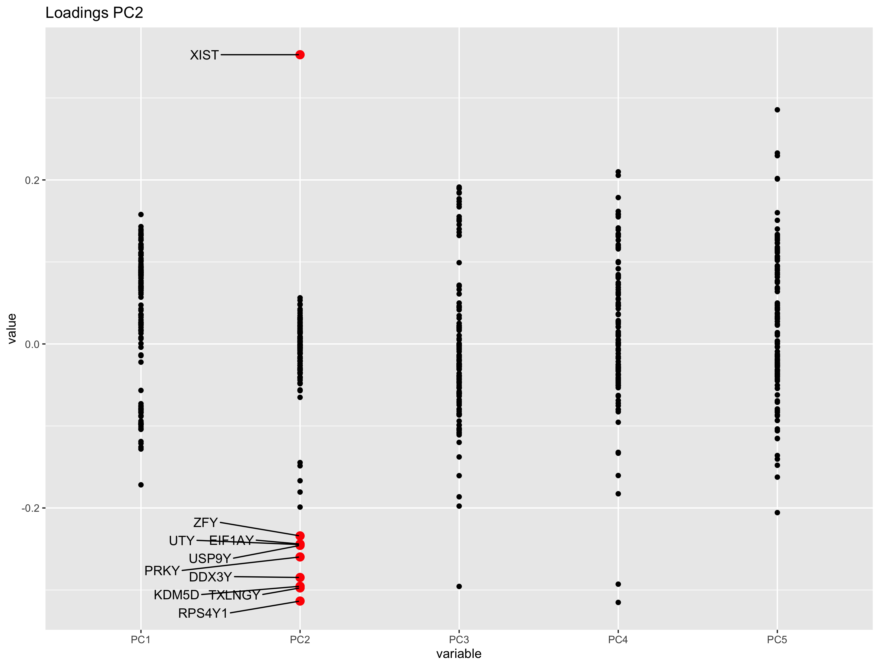
PCA: Principal Component 1 & 2
PCAtools
Genes involved in mucosal immuno response, uptake (pores, channels)
X-linked
Y-linked

Slide 10
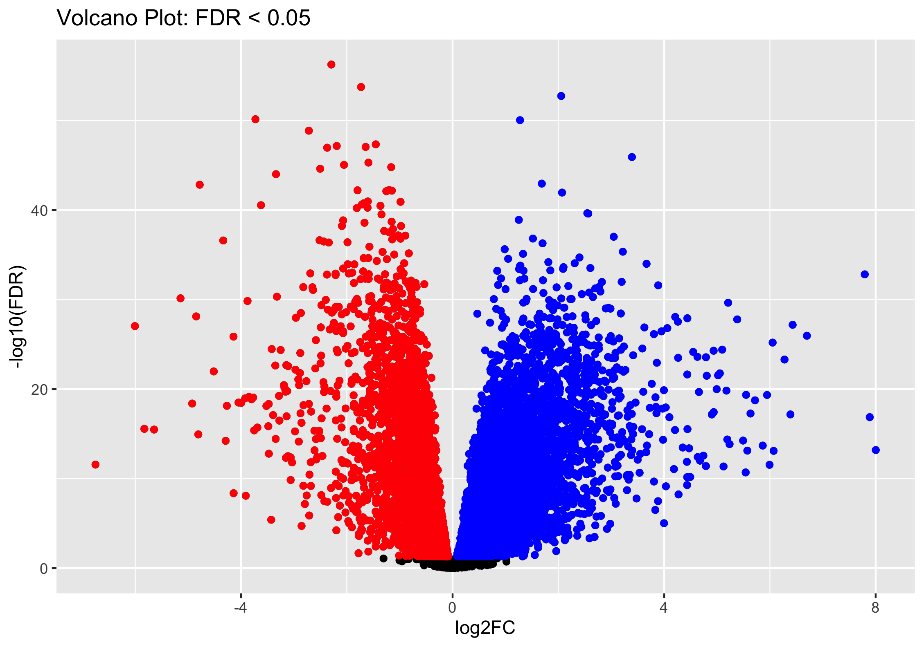
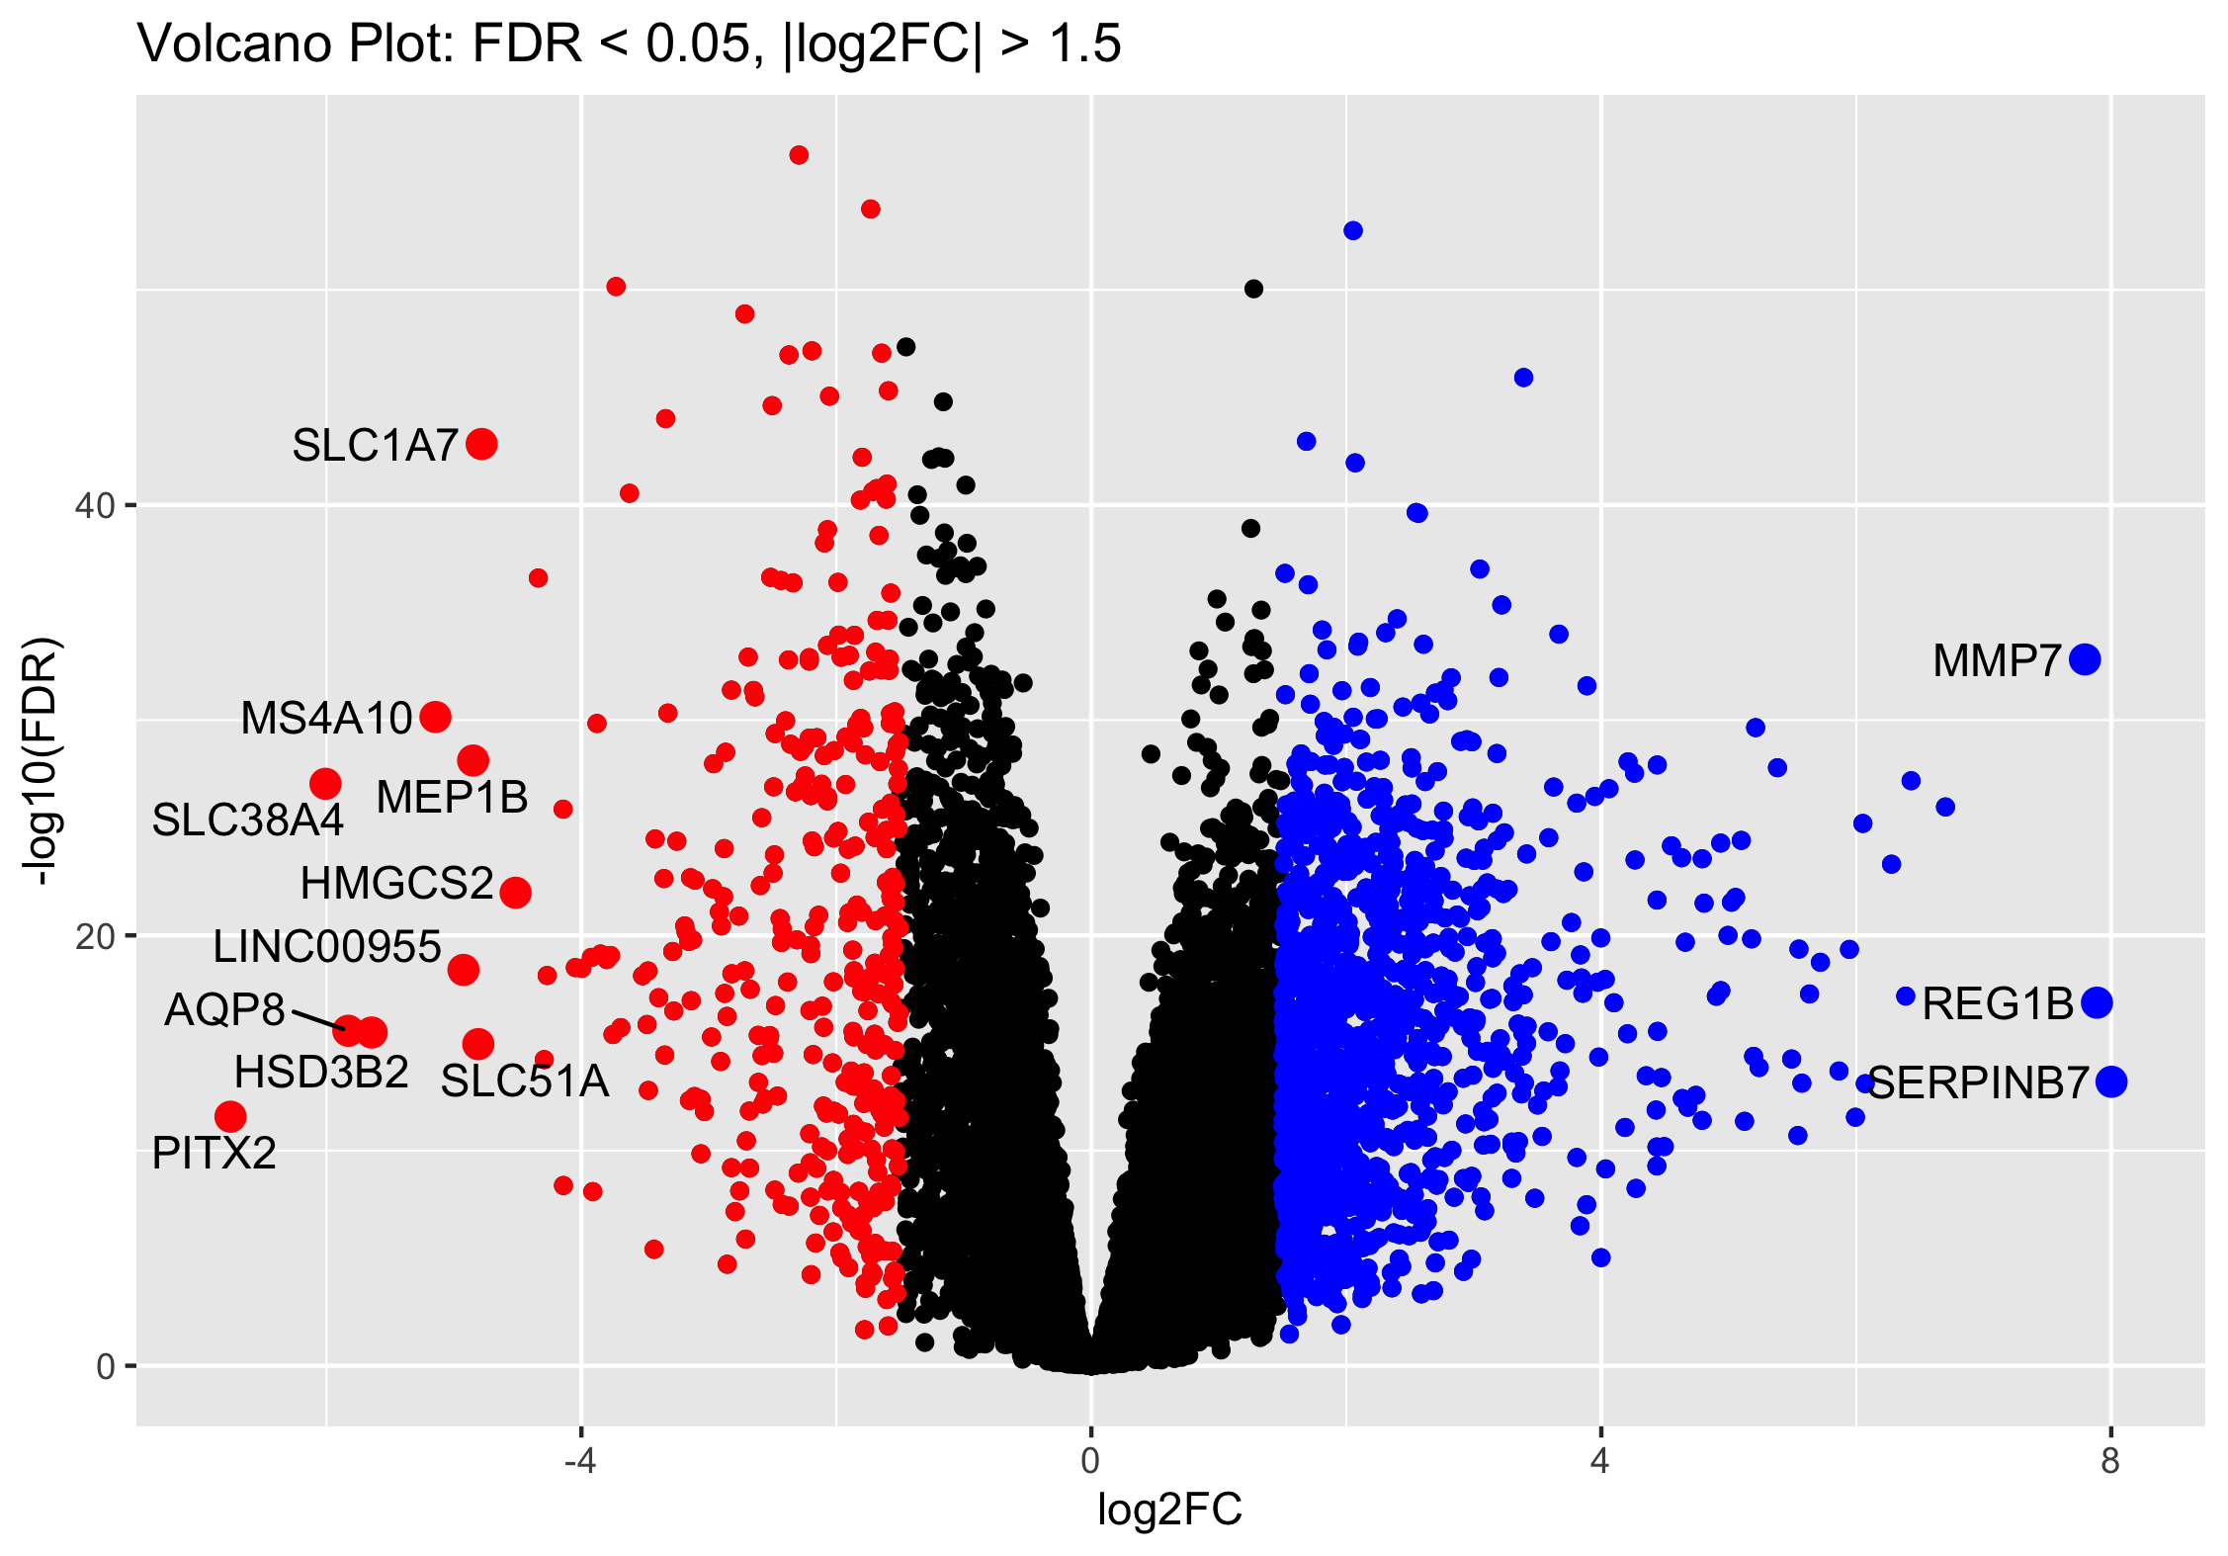
Differential Gene Expression Analysis
edgeR
Quantification of expression differences between samples based on statistical models
model complexities differ: => very simple, one factor model: Inflamed vs. Non-inflamed
=> more complex model: ~ Patient + Location + Inflammation

Slide 11
Differential Gene Expression Analysis
FDR > 0.05
FDR > 0.05, |log2FC| > 1.5
Notes:
KCNK5 & KCND3 : potassium channels
CDKN2B : cyclin dependent kinase inhibitor
ZNF: zink finger
NAADL: N-acetylated alpha-linked acidic dipeptidase
LRRN2: Leucine rich repeat neuronal 2
TMEM: transmembrane protein
This time I used z-scores => visualises the differences better

Slide 12
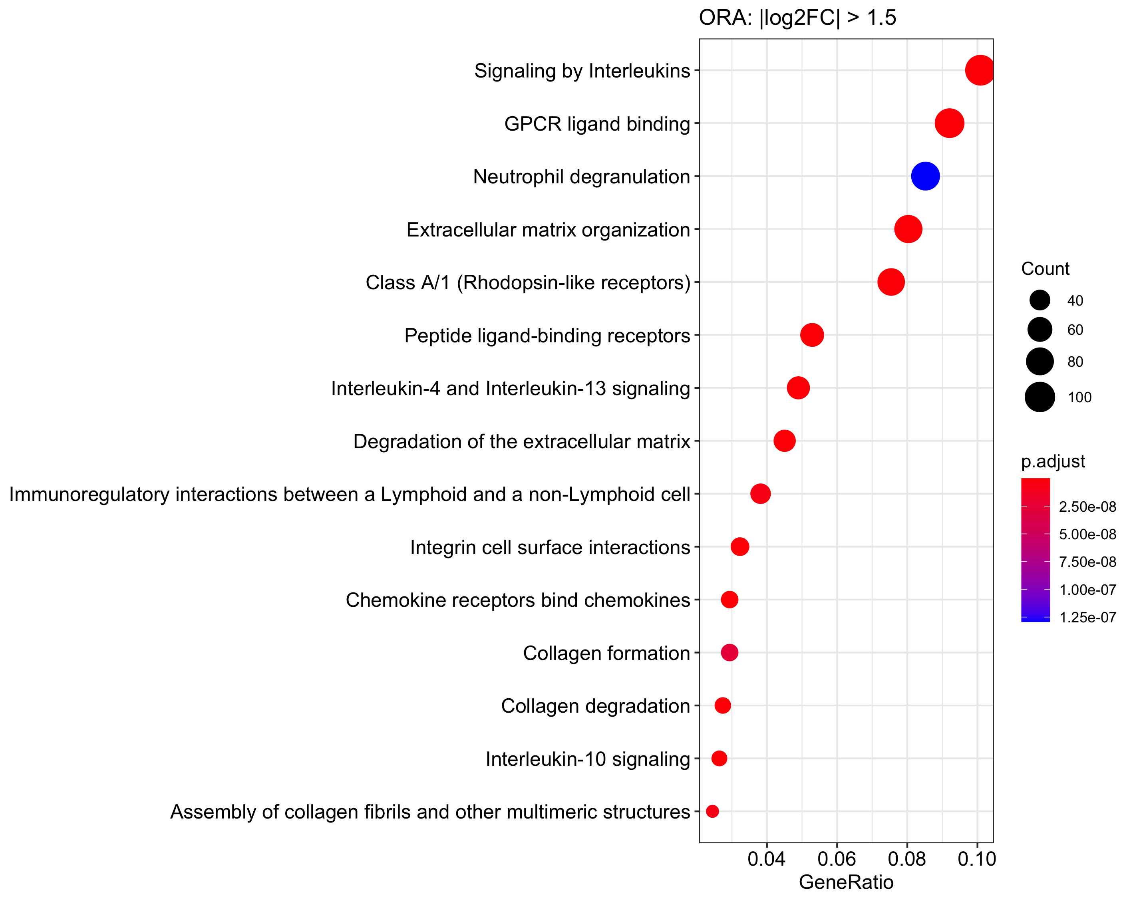
Over-representation Analysis
ReactomePA
Input: List of differentially expressed genes => are these genes significantly enriched in a specific pathway?
multiple testing correction: Benjamini-Hochberg
Notes:
hypergeometric testing => list of DE genes
BH: rank p values => (i/m)*Q => i = rank, m = #tests, Q = FDR (chosen)

Slide 13
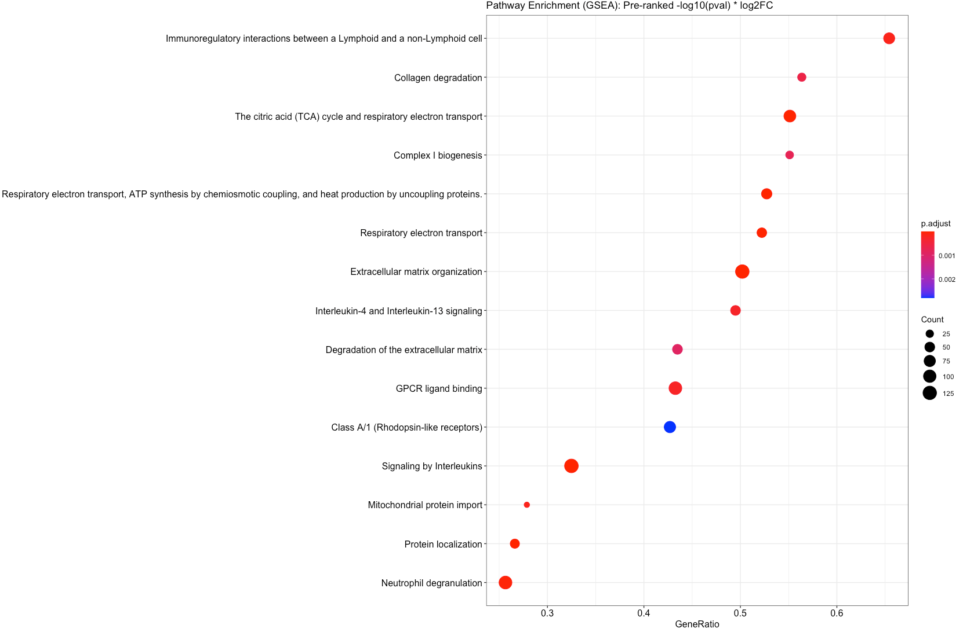
Gene Set Enrichment: Reactome
ReactomePA
Input: ranked gene list => Are the genes of a given gene-list under/over-expressed?
pre-ranking: -log10(padj) * log2FC
multiple testing correction: Benjamini-Hochberg
Notes:
underexpressed = bottom of ranked gene list
overexpressed = top of ranked gene list

Slide 14
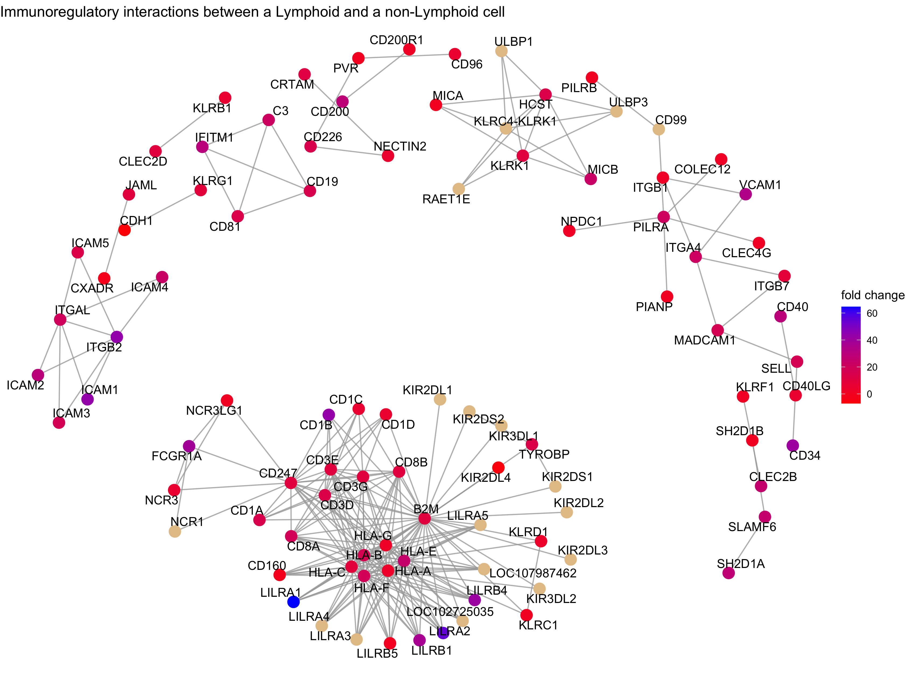
Gene Set Enrichment: Reactome
ReactomePA
pre-ranking: -log10(padj) * log2FC

Slide 15
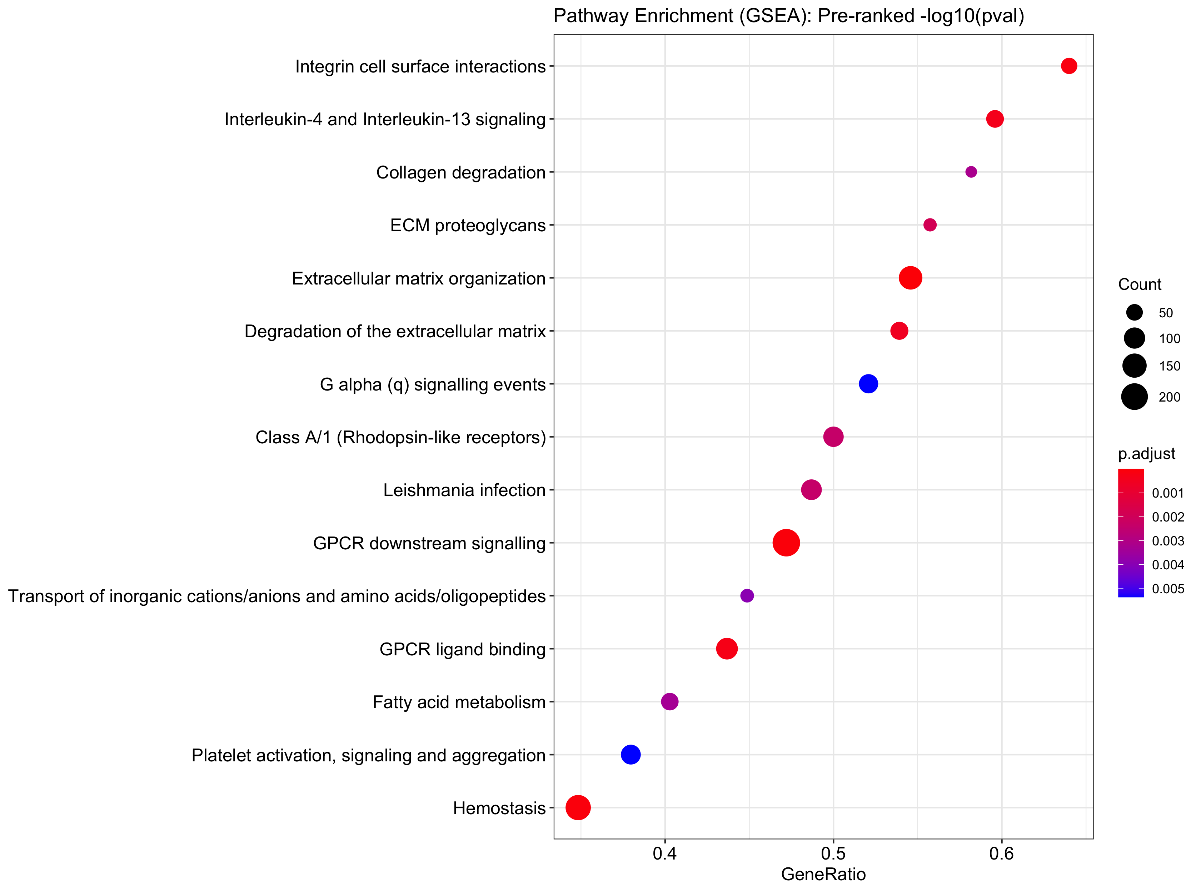
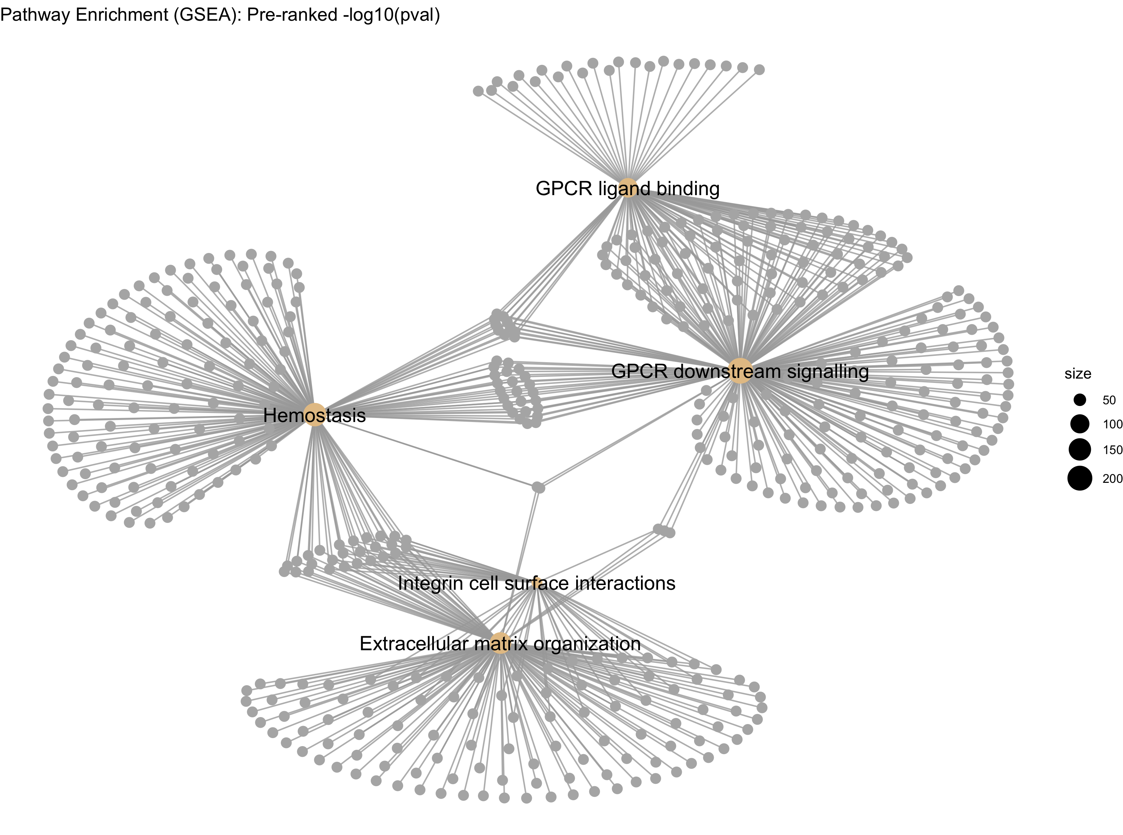
Gene Set Enrichment: Reactome
ReactomePA
pre-ranking: -log10(padj)
multiple testing correction: Benjamini-Hochberg

Slide 16
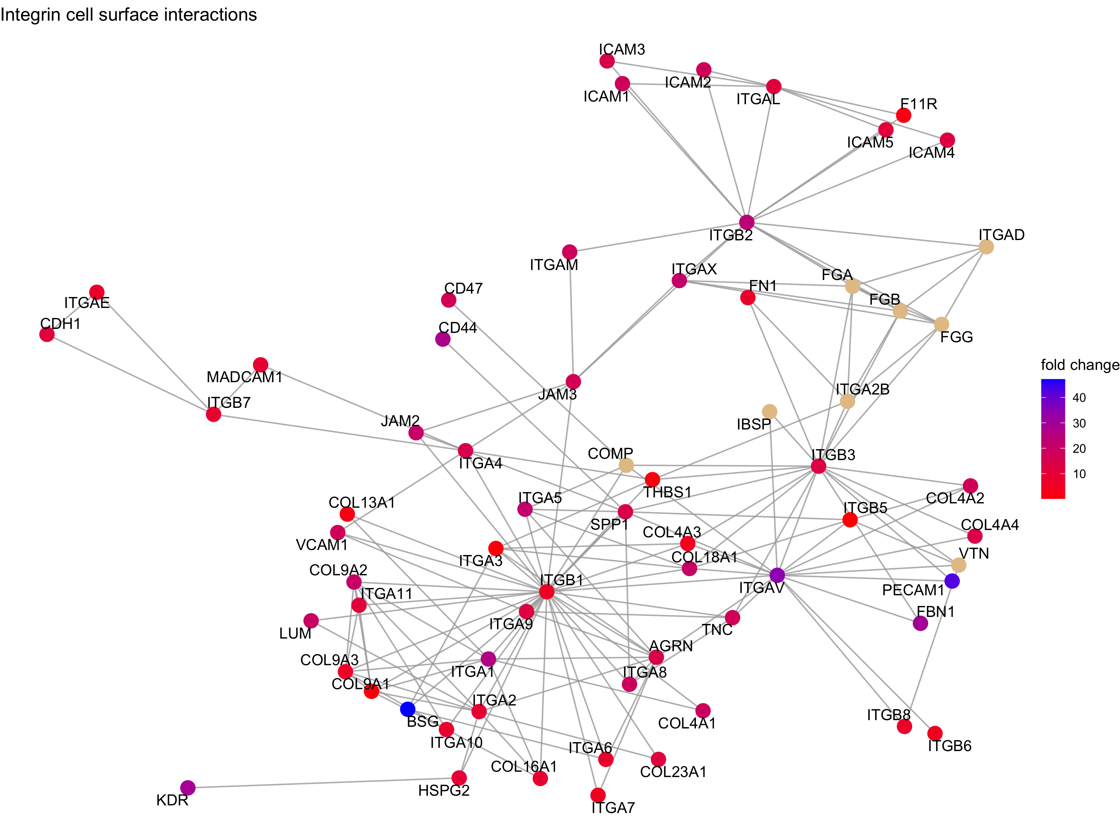
Gene Set Enrichment: Reactome
ReactomePA
pre-ranking: -log10(padj)

Slide 17
TissueEnrich
Tissue Enrichment
Input: List of differentially expressed genes => are these genes significantly enriched in a specific tisse?
multiple testing correction: Benjamini-Hochberg
Notes:
“Human Protein Atlas”
hypergeometric testing

Slide 18

Summary
PCA: Data seperates nicely along PC1 and PC2
PC1: Inflamed-Non-inflamed (+ location)
PC2: Patients
DE: Many differentially expressed genes between inflamed and non-inflamed samples.
Top DE genes sorted by log2FC are very similar to genes contributing to PC1
Most top DE genes show a consistent expression pattern across patients
Simple and complex model for DE show similar results
Pathway analysis: many pathways involved in intercellular signaling/contact, immune response/interleukin signaling
pre-ranking metric did not significantly alter analysis outcome
ORA shows very similar pathways to GSEA
biologically intuitive results
Notes:
pa: Independent of gene-ranking or method

